Slide 1

Playing FPS Game – Reinforcement Learning Deep Q-Networks
Tianshi Xie
Computer Science Dept.
Troy University

Slide 2
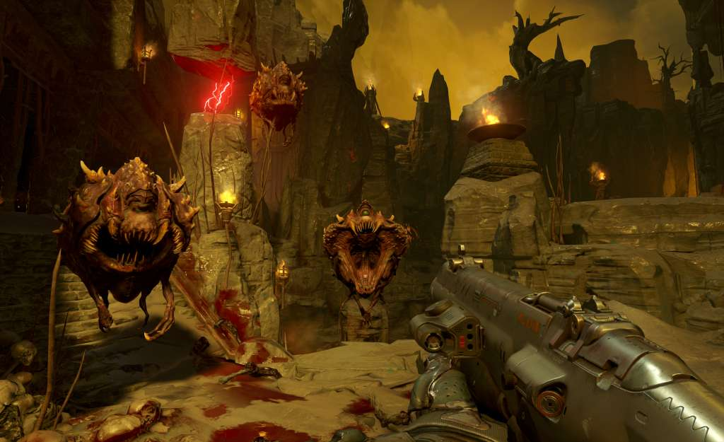
Abstract
Figure 1

Slide 3
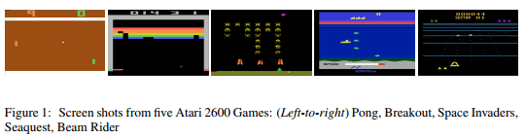
Introduction
Figure 2

Slide 4
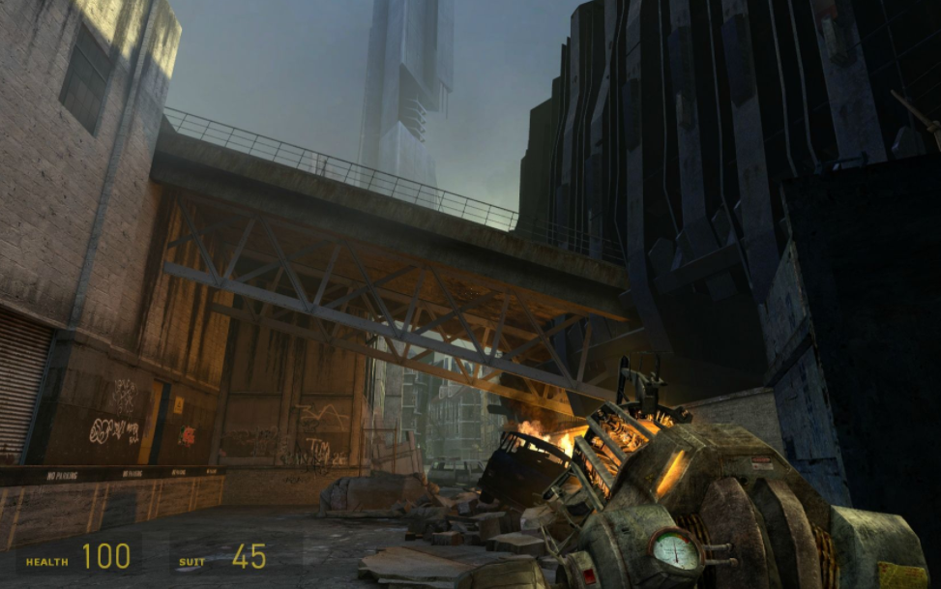
Introduction
Figure 3

Slide 5
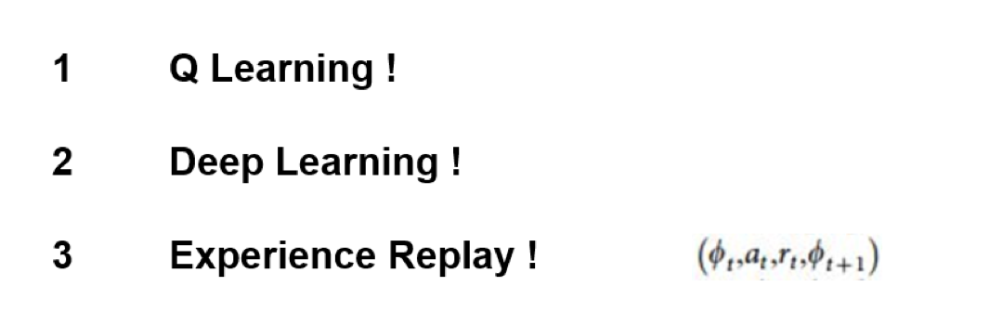
Background: Deep Q-learning Network(DQN)

Slide 6
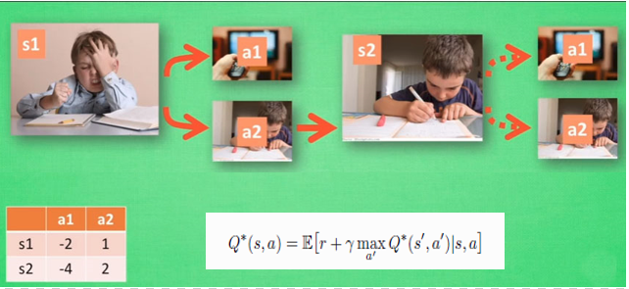
Q Learning
Figure 4

Slide 7
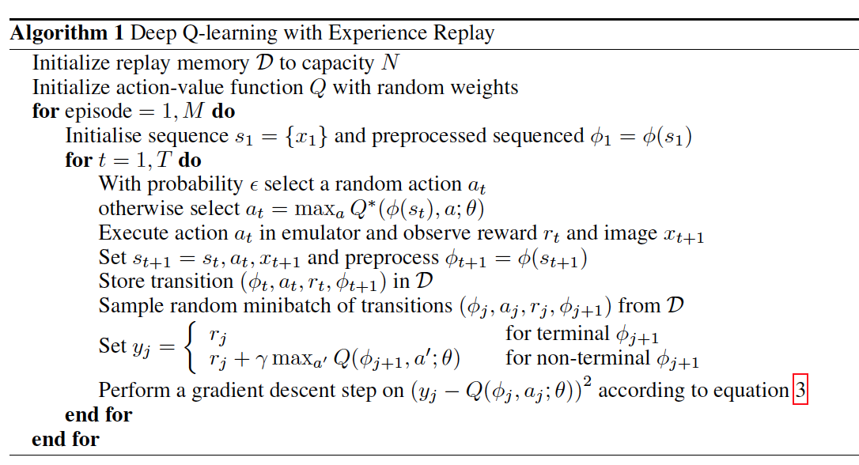
Deep Q-Networks
How many times the agent plays the game
Game start
Store one memory
Start learning
Backpropagation
Figure 5

Slide 8
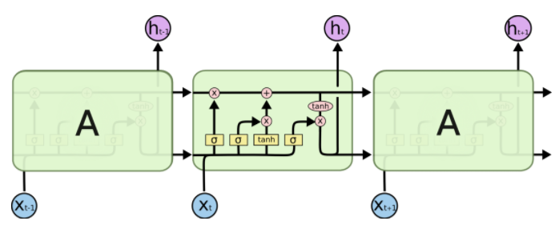
Background: Deep Recurrent Q-learning Network(DRQN)
LSTM
Figure 7

Slide 9
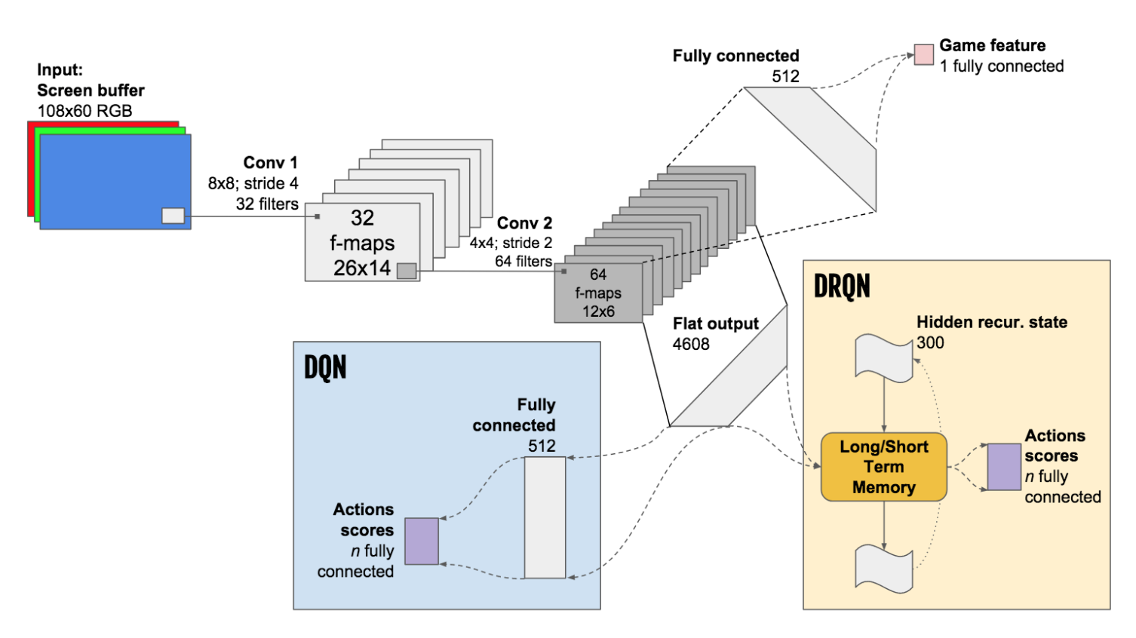
Architecture
Figure 6

Slide 10
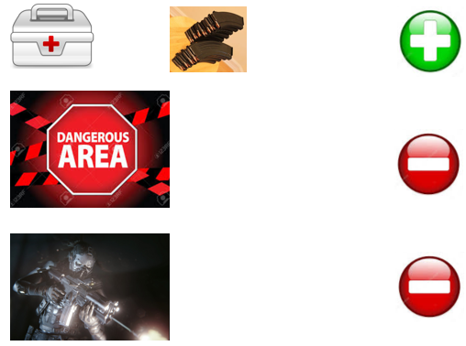
Training
Reward shaping

Slide 11
Future work
Figure 9
Figure 10

Slide 12
Conclusions
Deep Reinforcement Learning
Q learning
DQN
DDQN
DRQN

